Slide 1
Air Pollution Prediction based on CNN-LSTM model
Presented by lee seonggu
Sungkyunkwan University (SKKU), Korea
Notes:
Hello
In this time, I’ll talk about Air Pollution Prediction based on CNN-LSTM model

Slide 2
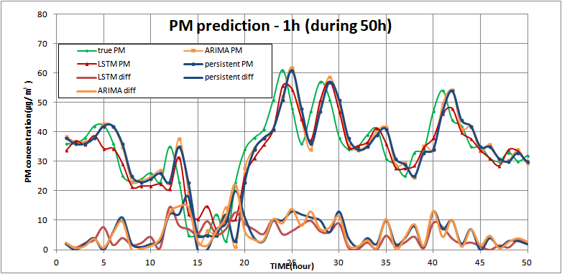
Last work
Last work is PM(Particulate Matter) prediction with simple LSTM model
Project Step
Preparing dataset (Suwon PM10 dataset)
Modeling and Training (with LSTM)
Prediction (get RMSE)
Evaluation
Result
Model | RMSE | Maximum error | Mean error | Standard deviation
PERSISTENT | 6.8638 | 59 | 4.727 | 4.978
ARIMA | 6.5501 | 53.27 | 4.609 | 4.690
LSTM | 5.2422 | 34.22 | 3.874 | 3.575
▶ more accurate model is needed that does not show time-shift result.
Notes:
In Last presentation. I made a simple LSTM model,
The result showed LSTM have a better performance than simple temporal prediction model
such as persistence or ARIMA
But, This result had a problem that follow prior data strongly, so It look like just time shift result.
So I’m finding other methods that do not show this effect.

Slide 3
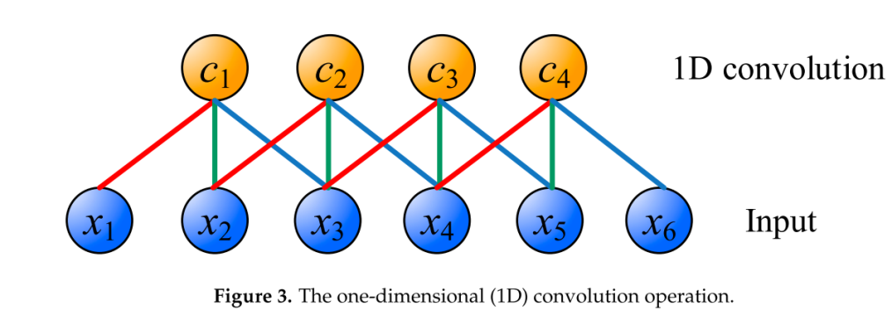
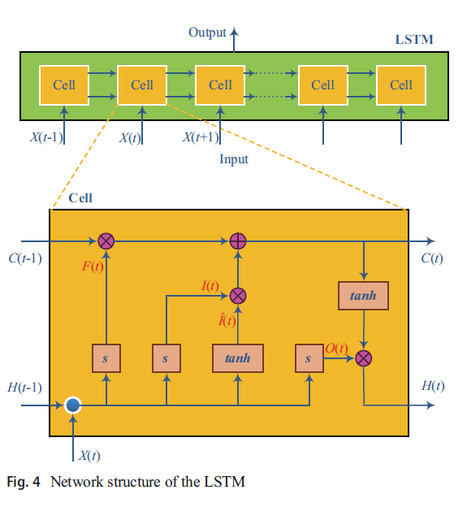
CNN-LSTM
1D CNN (1 Dimension Convolution Neural Network)
It can efficiently extract the inherent features from input data. (huge air quality and meteorological data).
LSTM (Long-Short Term Memory)
It can sufficiently reflect the long-term historic process of the input time series
data.
Notes:
So, What I have found is CNN-LSTM model that integrated
CNN and LSTM.
In this model, CNN is used to extract the inherent feature from input data.
and Because the pollution data is time sequence data,
It use one-dimensional convolution as shown this. Series Xn is time-sequence input data.
And This is connected to Series Cn, which is feature map.
Each connection has its weight value and the same color have the same weight value.
After the feature are extracted , LSTM is used to reflect the long-term historic process of the input time series
data.
In this paper, they uses the basic LSTM model
That contain 3 gate and Cell state.

Slide 4
1. A hybrid model based on convolutional neural networks and long short-term memory for ozone concentration prediction Unjin Pak, Chungsong Kim, Unsok Ryu, Kyongjin Sok, Sungnam Pak. Air Quality, Atmosphere & Health (2018)
Purpose on this paper
Constructing the effective structure of the CNN-LSTM hybrid model.
Predicting the next day’s 8-h average ozone
Notes:
So, I’ll introduce 2 paper using CNN-LSTM model.
First paper has 2 purpose.
First one is Constructing the effective structure of the CNN-LSTM hybrid model.
and second one is Predicting the next day’s 8-h average ozone.
Because I’m researching particulate matter prediction.
So I just focus on first purpose.

Slide 5
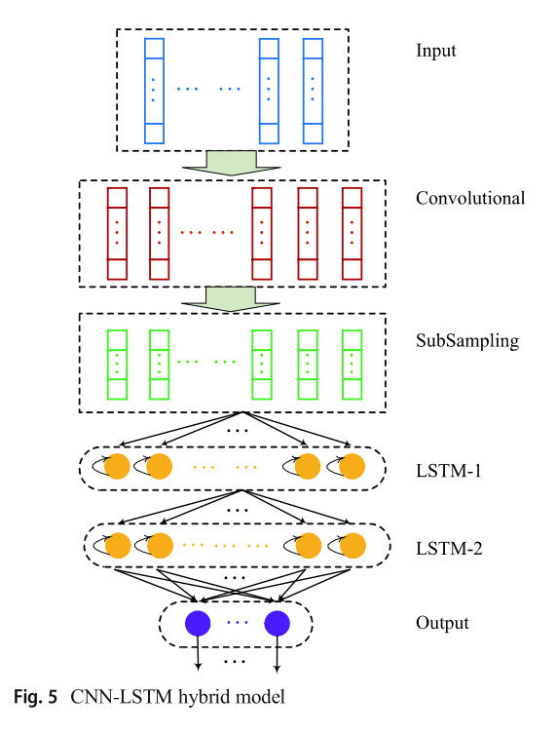
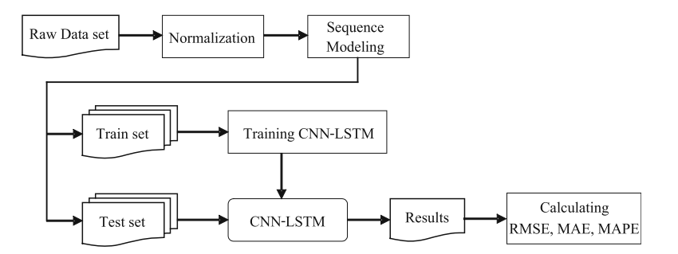
Overview
CNN-LSTM Model
Block Diagram
Notes:
This is overview that show what is the CNN-LSTM model structure and system process.
They used Convolutional and subsampling layer and
Double LSTM layer.
System process is similar to other model system
First they preprocessed raw data using normalization
and made Sequence Modeling, whose structure already show you on the left side.
and divide the input data set to training set and test set
So they train and test the model with different data set.

Slide 6
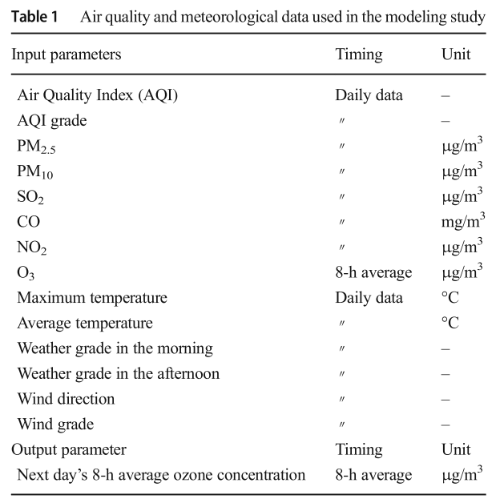
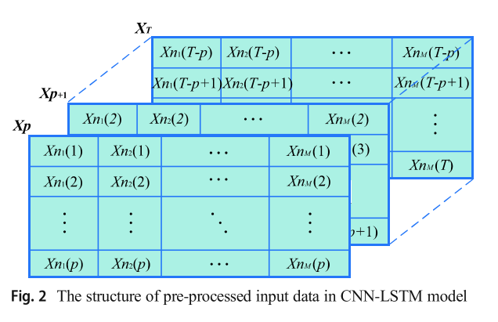
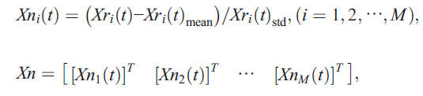
Input & Preprocessing
Parameter of dataset
Preprocessing
Dataset to predict data at time t+1
input feature
historical data
Notes:
Here is raw input data set and preprocessing method.
They use many kind of input parameter as shown on left side.
And output is next 8-h average ozone concentration.
And they normalized the data by using below equation
And the result show on right side.
Each table is one dataset to predict data at time t+1.
This row data means input feature series
And column data means historical data with time step p.

Slide 7
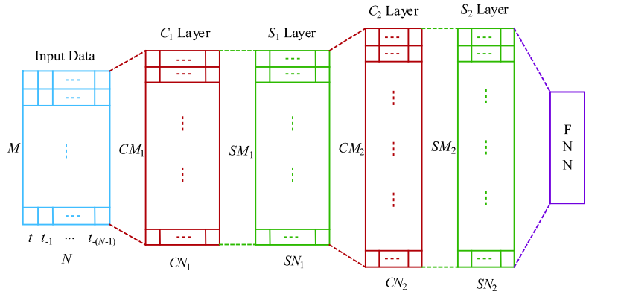
CNN Layer
CNN+ SubSampling Layer
1
CN1
 | …
CN1 = N− CK1 + 1
CN2 =SN1 − CK2 +1
SNi = CNi
CN2= CN1
W₁, W₂, .., W_{CK1}
 |  | …
1
2
N
Notes:
And this show CNN layer containing subsampling and Fully connected layer. M and N denote the numbers of input features and time lengths,
When input data enter CNN layer,
1D convolution operation applied Each row data like below.
They do not contain any padding. So, next time length decrease to N-CK1+1
(CK means kernel size).
Next, On Subsampling layer, the size of output dimension by average pooling is reduced.
Actually, I got confuse why Sni is same to Cni on the paper.
I think Sni will be reduce because subsampling layer reduce the dimension.
Anyway, it use same CNN and Subsampling layer again in order to give the model a good chance of learning features from the input data.
After the CNN and pooling, the output enter FNN (that means Fully connected layer).
This will be LSTM layer input

Slide 8
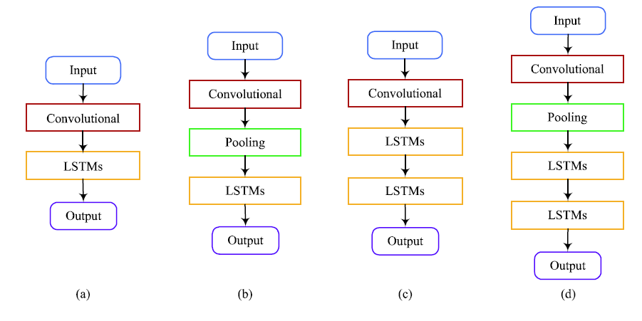
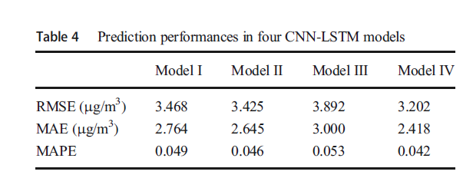
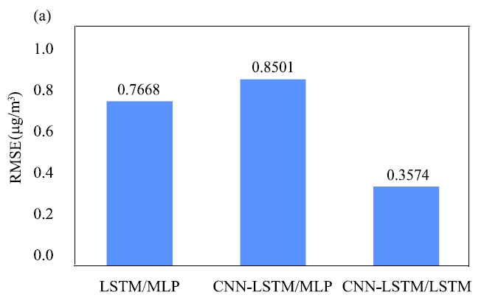
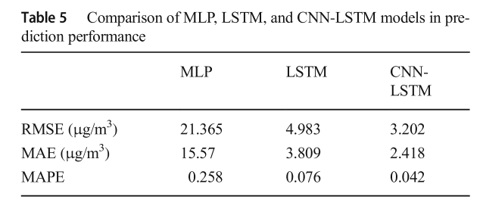
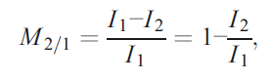
Result
(1) Comparison of CNN-LSTM base models
Model(a)~(d) correspond to Model I~Ⅵ
(2) Comparison of other models
Performance index comparison
performance improvement (rate)
Notes:
They made 4 kind of model based on CNN-LSTM
Model (a) To (d) correspond to model 1 to 4 on the right side table.
model A is basic model that just contain CNN and LSTM layer
model B add one pooling layer on basic model.
model C add one LSTM layer.
And model D add both of one pooling and one LSTM layer.
As you can see on the table, model d show the best result.
And model c show the worst result.
It means that pooling layer is important to improve performance
When the model complexity get bigger.
And they also compared this to other model such as MLP or LSTM.
On this result CNN-LSTM also show better performance than MLP and LSTM.
(compared to LSTM, this model get 35% more better performance.
(M2/1 denotes the performance improvement 2, compared to model 1.)

Slide 9
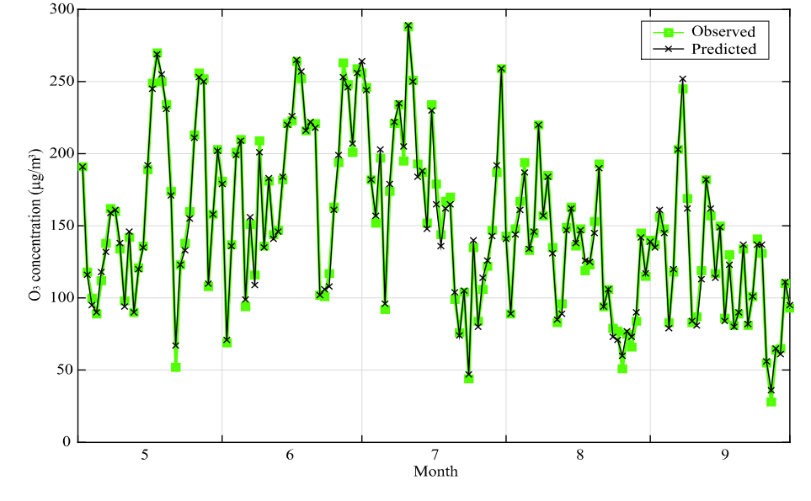
Result
(3) Comparison of Observed and Predicted value (during May to September 2017 by the CNN- LSTM model IV)
Notes:
Last graph show Comparison of Observed and Predicted value
Y-axis means next- 8 hour Ozone concentration
And X-axis is time axis.
As you can see, the result do not show any shift effect that follow prior data.
But What we have to check carefully is that the data is not PM concentration data and
This value is 8-h average value, not 1hour value.
This is the end of first paper explanation.

Slide 10
2. A Deep CNN-LSTM Model for Particulate Matter (PM2.5) Forecasting in Smart Cities Huang, C.-J.; Kuo, P.-H. Sensors 2018
Purpose on this paper
Develop APNet(Air pollution Network) that integrates the CNN and LSTM architectures to predict PM2.5 concentration.
Compare to several popular algorithm.
Notes:
And Next paper focus on PM concentration prediction.
In this paper, It also made CNN-LSTM based model.
But they did not describe how they make model in detail. So I just focused on what kind of method they used and comparisons of other models.

Slide 11
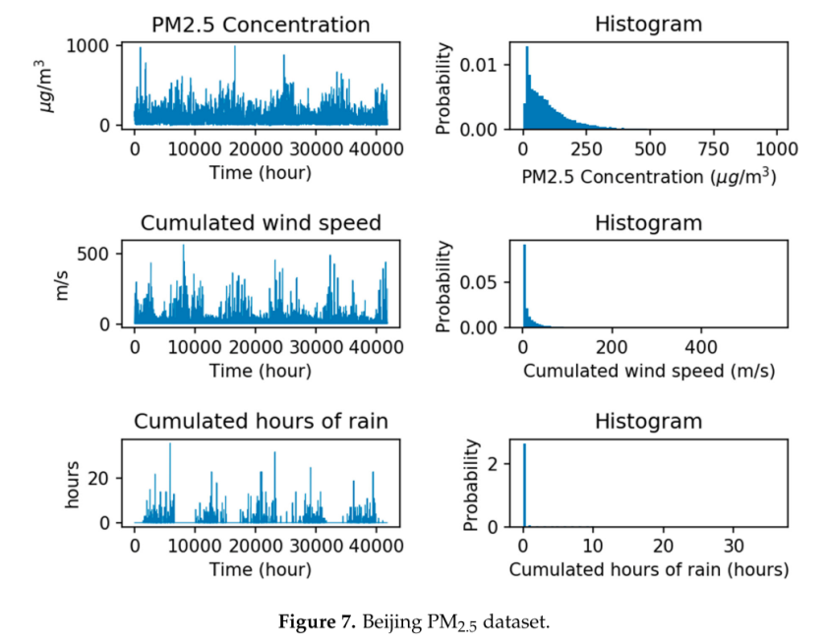
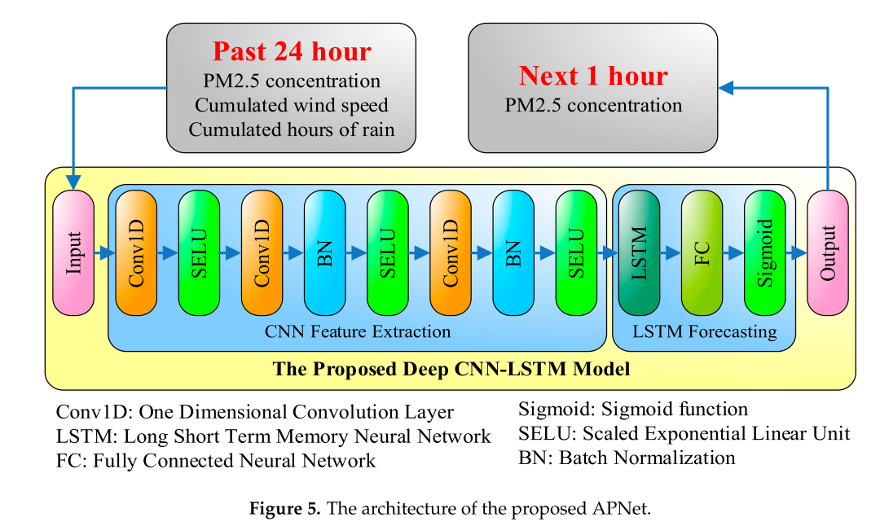
Overview
Input dataset
CNN-LSTM Model
Input data
CNN-LSTM Model
Notes:
This is overview of this paper showing input dataset and CNN-LSTM model.
It only used 3 kind of input feature.
It’s so simple, compare to prior paper.
The figure on right side show CNN-LSTM Model they made.
They used past 1day historical data, and
This data enter triple CNN layer containing SELU activation function and
Batch normalization.
And after feature extraction by using CNN, LSTM layer forecast
Next 1 hour data.

Slide 12
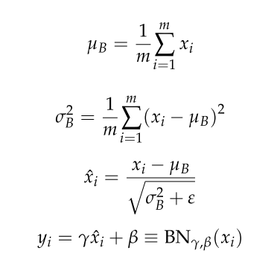
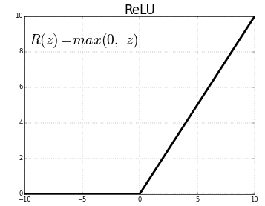

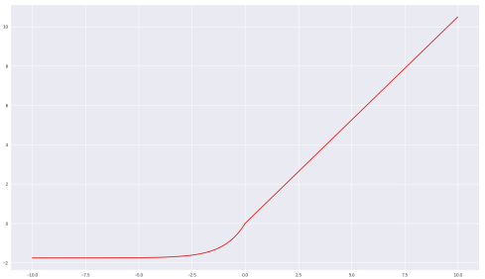
Method
Batch Normalization.
Avoid overfitting and gradient vanishing/exploding problem.
Reduce Learning time.
x_{i} - input value
y_{i} - output after batch normalization
m - mini-batch size
µ_{B} - mean of all the inputs in the same mini-batch
σ²_{B} - variance of the input in a mini-batch
2. SELU(Scaled Exponential Linear Units)
It is activation function that replace RELU(Rectified Linear Unit).
It also avoid gradient vanishing/exploding problem.
Notes:
They did not any mension about how to make CNN and LSTM layer, so
I just introduce two methods that the CNN-LSTM model used.
First one is Batch Normalization.
Compare to normalization on prior paper, This normalization apply each batch separately.
On this equation, xi is input value and m is mini-batch size.
What is critical point is It use scale factor and shift factor that can be trained to improve performance
It has advantages on overfiting and gradient vanishing/exploding problem
And it can reduce learning time.
Second on is SELU activation.
Instead of using RELU activation, it used SELU to avoid avoid gradient vanishing/exploding problem.

Slide 13
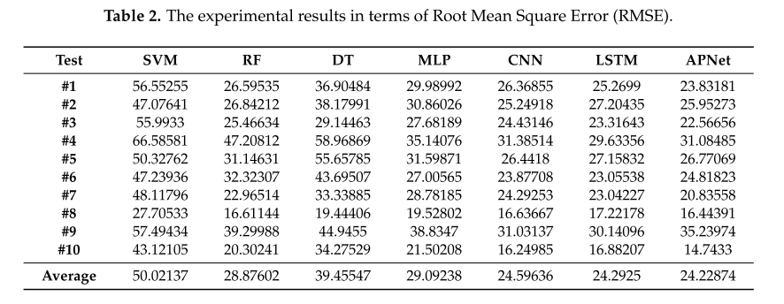
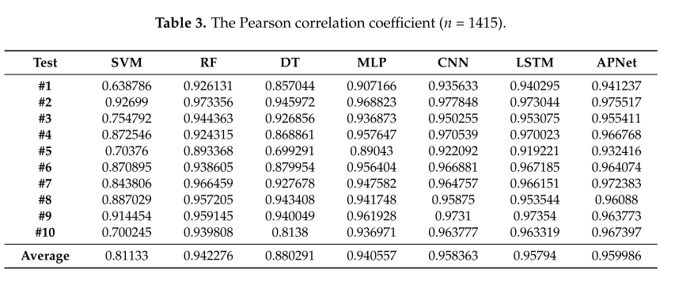
Result
Notes:
This slide show the result of CNN-LSTM performance comparing other althorithm.
In this paper, SVM show the worst result.
Comparing to APNet that use LSTM, SVM has three time RMSE.
Next worst result is Decision tree
And Random forest and MLP show similar result.
CNN and LSTM model show a quite better result than previous models.
But the best model is hybrid of CNN and LSTM model.

Slide 14
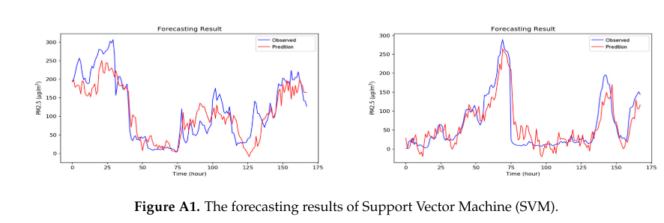
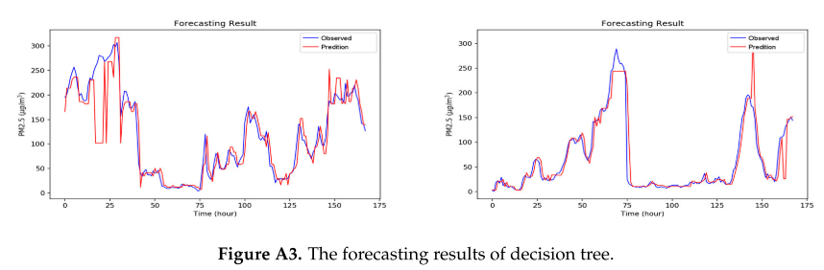
Result
Notes:
This paper also compared observed value and predicted value on each algorithm.
Two worst algorithm show that they predict so weird and have many high error prediction.

Slide 15
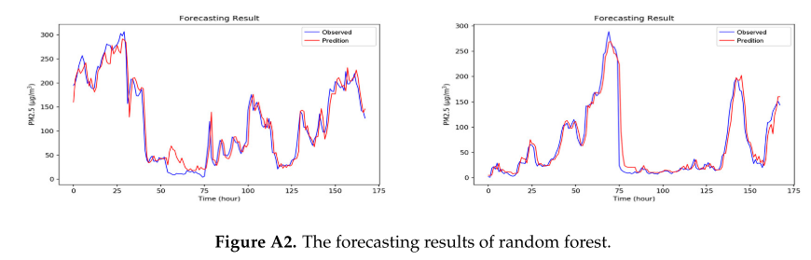
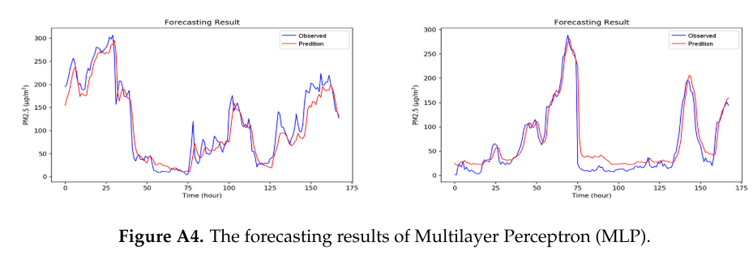
Result
Notes:
Next two moderate algorithm show better prediction then the worst algorithm
But the predict value have some deviation in all range.

Slide 16
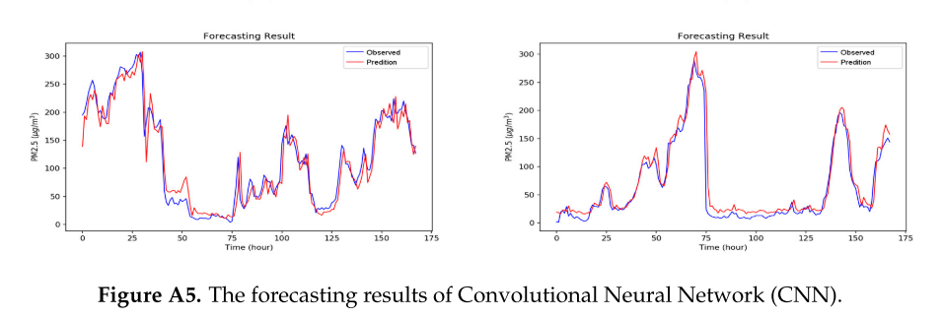
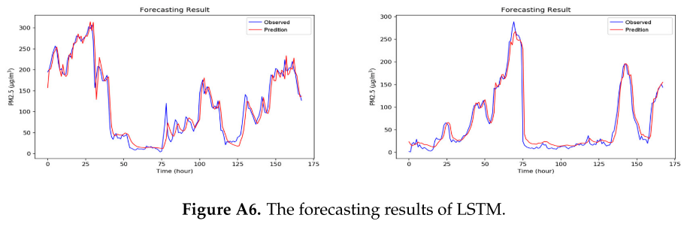
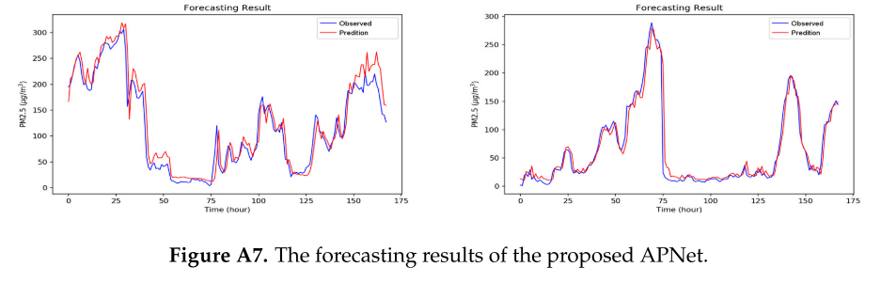
Result
Notes:
Last Three algorithm show good prediction.
Almost in all range, the observed value match to prediction value.
Especially, in APNet, this prediction value is very similar to real value on graph of right side.
But it has also deviation on certain range.
So It is not perfect model but better model then other.

Slide 17
Conclusion
1. Both of papers verify that CNN-LSTM model is better than LSTM or CNN model.
2. In first paper, Subsampling layer and double LSTM layer make the result better.
3. In second paper, It is reasonable to add Batch normalization and SELU to training.
> next work is making CNN-LSTM based model using those method.
Notes:
So my conclusion can be summarized in three ways.
Frist, CNN-LSTM model is better than LSTM or CNN model.
2. In first paper, Subsampling layer and double LSTM layer make the result better.
3. In second paper, It is reasonable to add Batch normalization and SELU to training
To verify whether those method can really improve result, I’ll apply those method on my case.

